Slide 1
Data Analysis Portfolio
Prepared by: Sai Kumar
1

Slide 2

Table of Contents
Professional Background
Project Description
Problem
Design
Findings (1,2,3)
Analysis conclusion
2

Slide 3

Professional Background
I am a recent graduate from GITAM University, batch of 2024, holding a degree in Electronics and Communication Engineering (ECE) with a specialization in Artificial Intelligence and Machine Learning (AIML). As an aspiring data analyst, I have gained proficiency in Python, SQL, Excel, and Tableau through hands-on experience in various real-world projects. These projects have helped me build a strong foundation in data extraction, manipulation, visualization, and interpretation. My primary focus is on utilizing data-driven insights to aid decision-making and drive meaningful business outcomes.
3

Slide 4

NAMMA YATRA Project Description
The dataset analyzed in this project is from NAMMA YATRA, an open network mobility app designed to offer commuters multi-modal services without intermediaries. Built on ONDC's common network standards and the open-source Beckn protocol, the app allows interoperability across compliant platforms. This report presents key findings and insights gained through thorough data cleaning and visualizations, with the aim of uncovering meaningful trends and patterns in the dataset.
NAMMI
YATRA
4

Slide 5
The Problem
You’re a Data Analyst working for a Namma Yatri company, RideX. Your manager, the Head of Operations at RideX, has tasked you with presenting a comprehensive report on various performance metrics for the company. The objective is to identify trends, uncover areas for improvement, and provide actionable insights to enhance overall service efficiency and profitability. The manager needs to present this report to the CEO in the upcoming board meeting, which is in two weeks.
The analysis will provide insights into driver performance, customer behavior, and service efficiency, enabling RideX to enhance operational strategies, improve customer satisfaction, and increase profitability. The findings will be presented to the CEO with actionable recommendations for optimizing service delivery, enhancing financial performance, and improving overall customer experience.
5

Slide 6

DESIGN
Steps taken to clean the data:
First importing the datasets provided and merging them.
Then removing the duplicates and the blank cells.
Improving the headers of each column with proper values.
Finding and replacing the data with correct values.
6

Slide 7
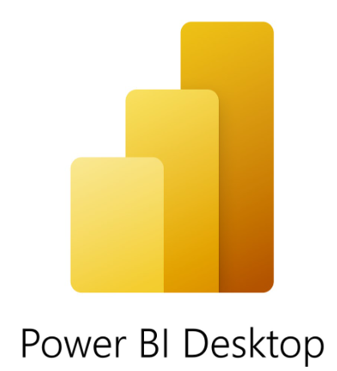


Tools used for visualization
Power BI
SQL
Excel
7

Slide 8
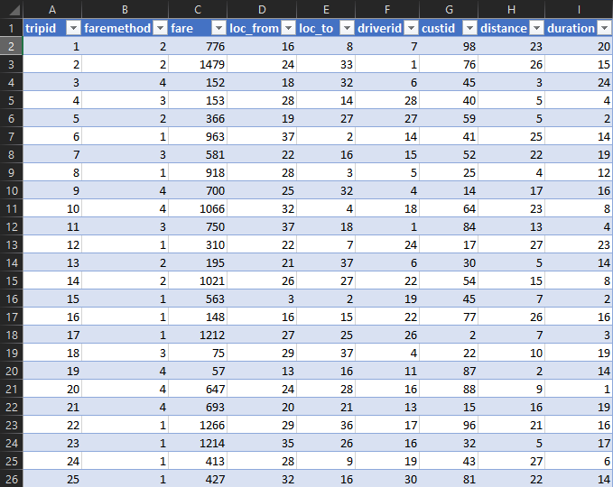
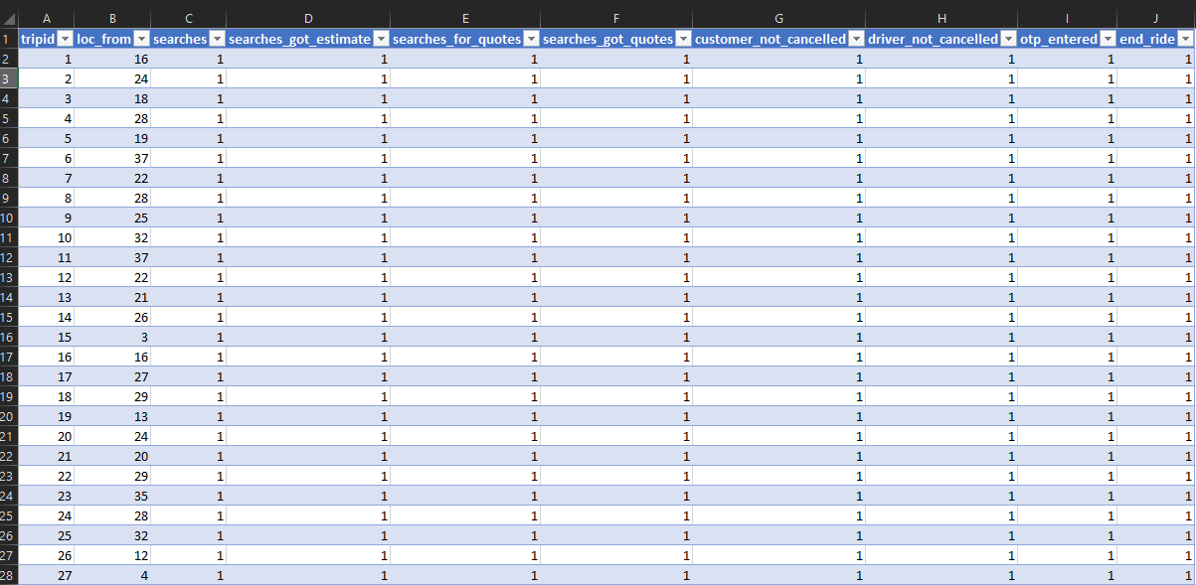
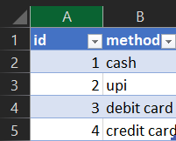
Dataset Images
8

Slide 9
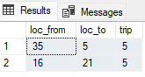
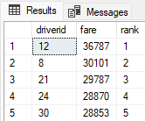
Finding-1
Fig 1:
select top 2 loc_from,loc_to,count(distinct tripid) as trip from trips
group by loc_from,loc_to
order by count(distinct tripid) desc;
Fig 2:
select * from
(select * ,dense_rank() over(order by fare desc) as rank
from
(select driverid,sum(fare) as fare from trips group by driverid)b)c
where rank < 6;
Output 1:
Output 2:
Fig 1:which two locations had the most trips
Fig 2: top 5 earning drivers
In Figure 1, it is observed that Location 1 and Location 2 both have the highest number of trips, with 5 trips each.
In Figure 2, among a total of 300 drivers, only 5 drivers are identified as top earners.
9

Slide 10
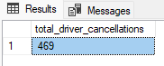
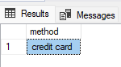
Finding-2
Fig 1:total driver cancelled
SELECT COUNT(*) AS total_driver_cancellations
FROM trips_details2
WHERE driver_not_cancelled = 0;
Fig 2:which is the most used payment method
select a.method
from payment as a
inner join(
select top 1 faremethod,count(distinct tripid) as trip_count from trips
group by faremethod
order by trip_count desc) as b
on a.id = b.faremethod;
Output 1 :
Output 2 :
Fig 1: total driver cancelled
Fig 2:which is the most used payment method
In Figure 1, the total number of trips canceled by drivers is 469.
In Figure 2, the most frequently used payment method for trips is highlighted.
10

Slide 11
Finding 3
In the next slide, you’ll see a dashboard image for Namma Yatra, a transportation app that allows users to negotiate directly with drivers for various locations.
Total no of users
Total no of searches
Trip vs Duration
Distance Vs Duration
Completed Trips
11

Slide 12
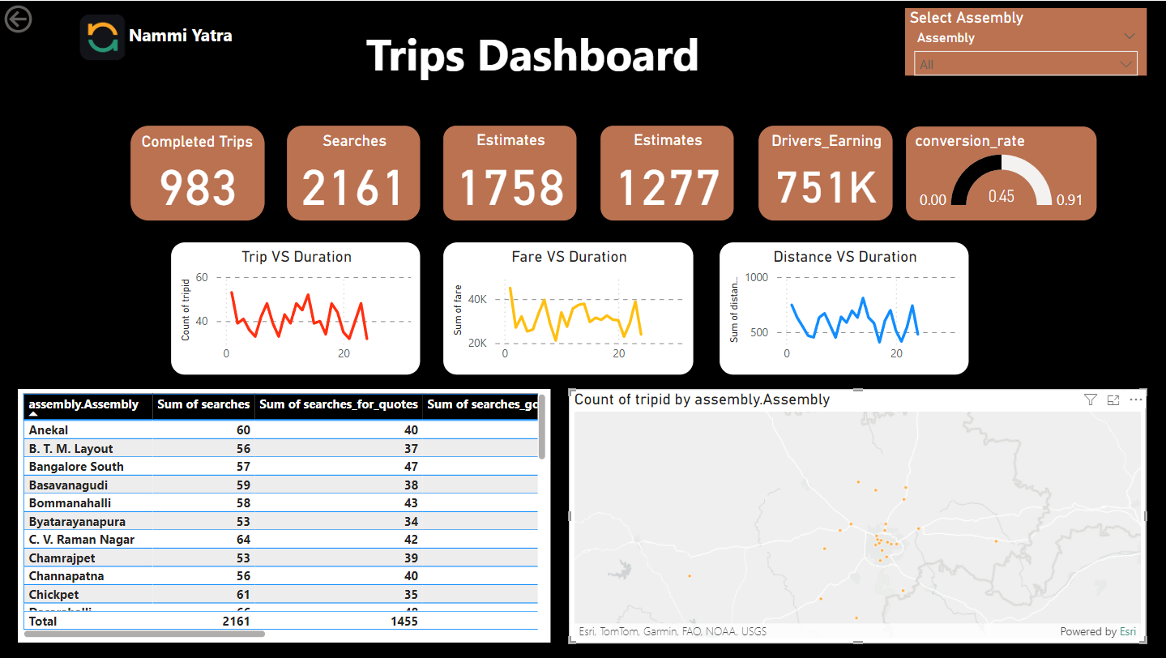
Finding 3

Slide 13
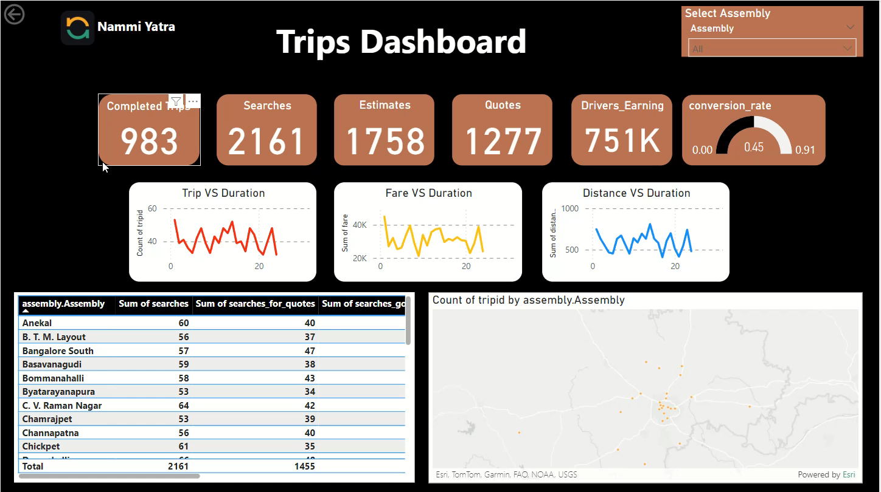

Slide 14
Analysis
After the analysis, I found the following:
Number of Users Searching: 2,161
Total Trip Distance: 14,148 km
Sum of Trip Fares: $751,343
14

Slide 15
conclusion
In conclusion, our thorough analysis allowed us to extract valuable insights from the data and create meaningful graphs. What initially seemed like inconsequential data ultimately proved invaluable, providing us with a deeper understanding of user behavior and access patterns.
15

Slide 16
DATASET LINK: https://docs.google.com/spreadsheets/d/1muCcb2aTJMnp8evprZOG33FUe060nLhi/edit?usp=sharing&ouid=117038589761866819009&rtpof=true&sd=true
SQL FILE LINK: https://drive.google.com/file/d/1KRd9qqQnbm009t6sYefAhX1crF7WGYdM/view?usp=sharing
Power BI LINK:
https://drive.google.com/file/d/1WgWnAyYSsOBgsuz4-Lt3_DZgOKP15NSM/view?usp=sharing
16

